Slide 1
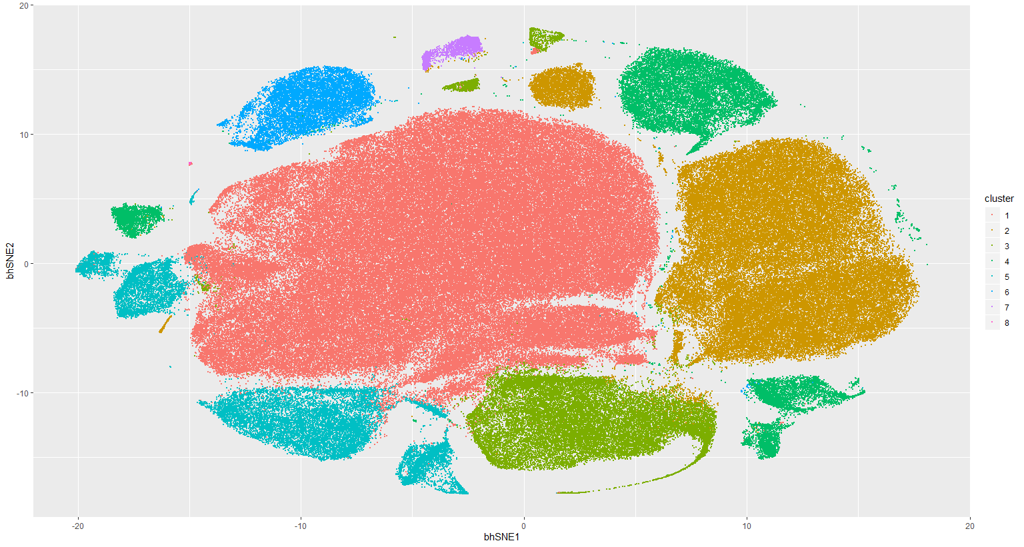
Notes:
ccRCC_652T_Tcells 8

Slide 2
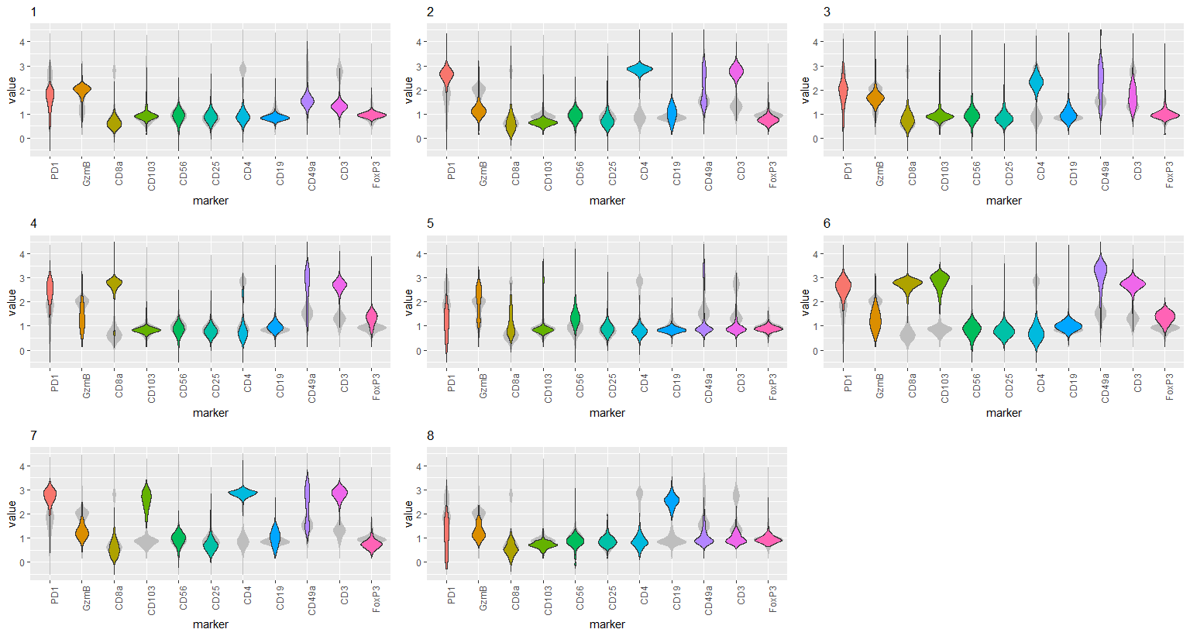
Notes:
ccRCC_652T_Tcells 8

Slide 3
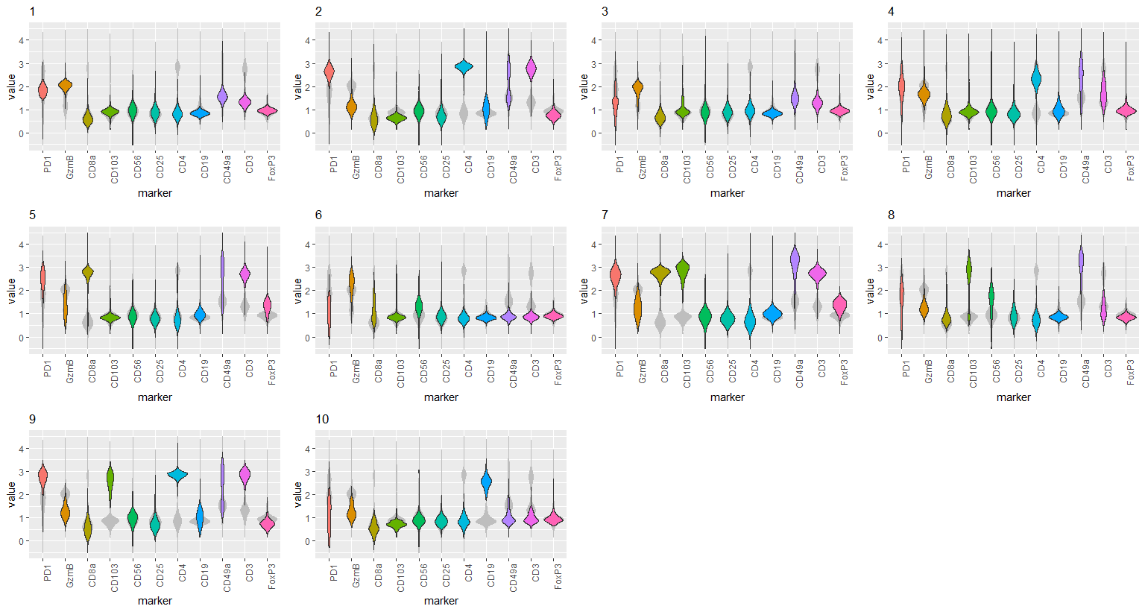
Notes:
ccRCC_652T_Tcells 10

Slide 4
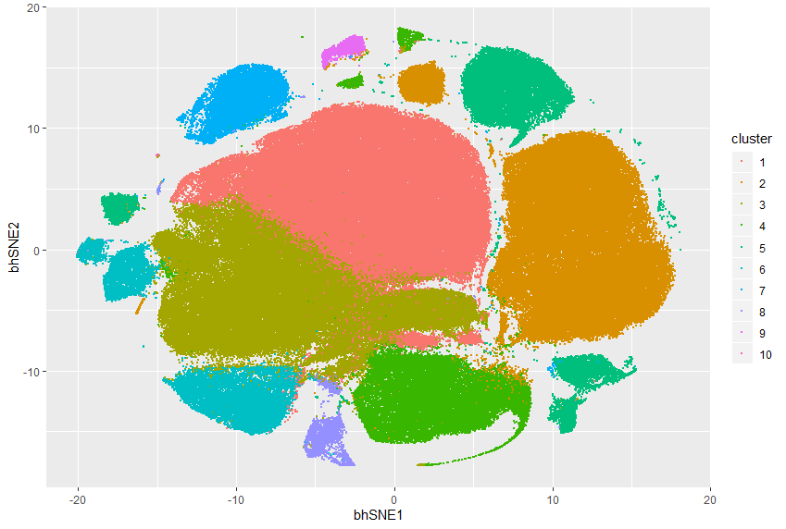
Notes:
ccRCC_652T_Tcells 10

Slide 5
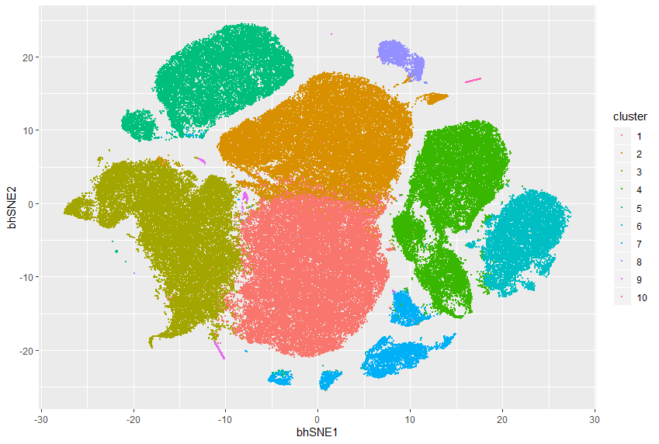
Notes:
ccRCC_652T_Tcells 10 removal of insensitive cluster

Slide 6
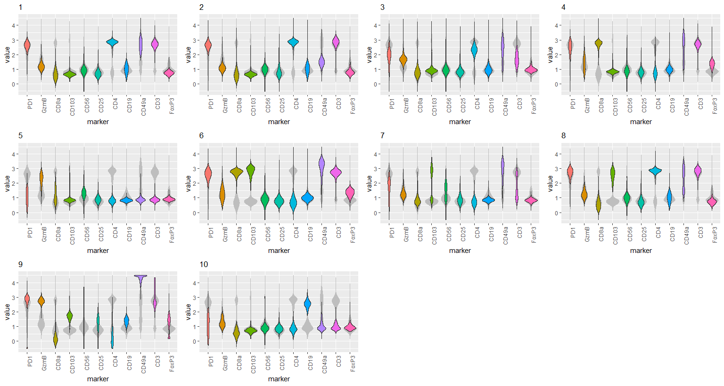
Notes:
ccRCC_652T_Tcells 10 removal of insensitive cluster

Slide 7
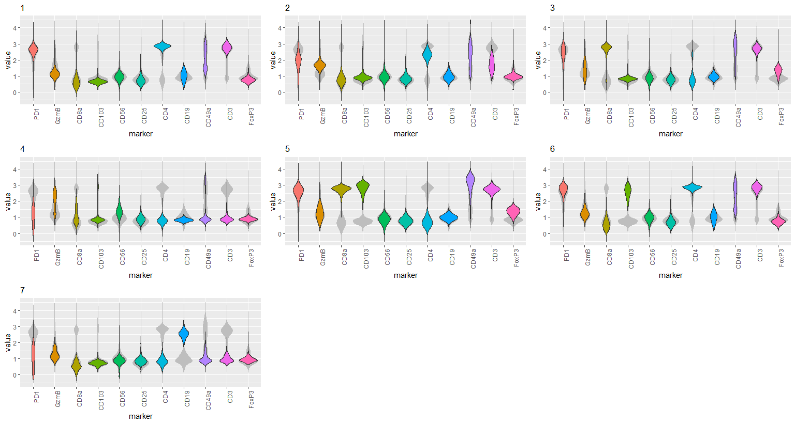
Notes:
ccRCC_652T_Tcells 7 removal of insensitive cluster

Slide 8
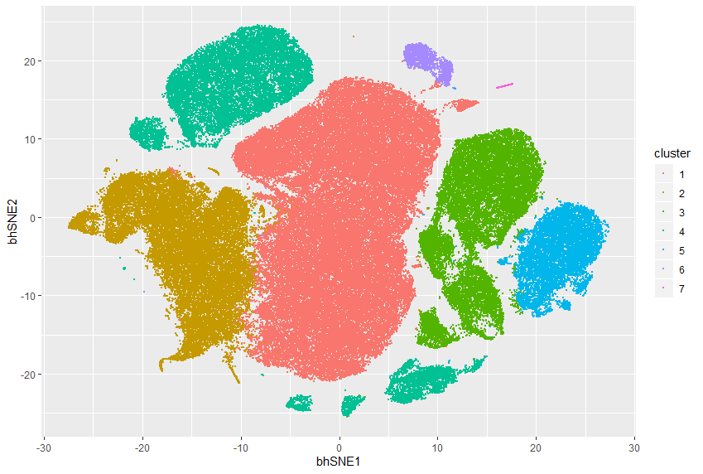
Notes:
ccRCC_652T_Tcells 7 removal of insensitive cluster

